Slide 1
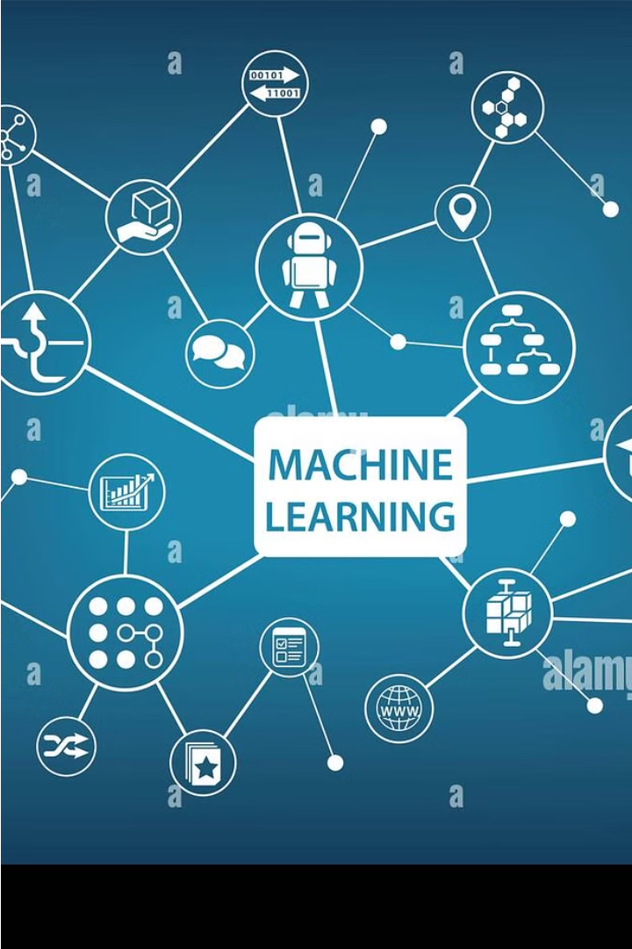
Introduction to Machine Learning
Machine learning is a rapidly growing field that allows computers to learn and improve from experience without being explicitly programmed. It has applications in areas like image recognition, natural language processing, and predictive analytics.

Slide 2


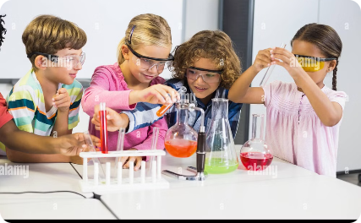
How Humans Learn Things
Observational Learning
Learning Through Instruction
Experiential Learning
Humans learn a great deal by observing others and imitating their behaviors. This allows us to acquire new skills and knowledge without having to start from scratch.
Humans learn effectively by actively engaging with the world around them, experimenting, and learning from their mistakes. This allows us to develop practical skills and deeper understanding.
Formal education and training provide structured learning opportunities that help humans quickly gain knowledge and master complex topics through lectures, books, and hands-on practice.

Slide 3


Comparison Between Learning by Humans and Machines
Human Learning
Machine Learning
Humans learn through experience, observation, and trial-and-error. We build knowledge and skills over time, drawing insights from our diverse backgrounds and social interactions.
Machines learn by processing large datasets and identifying patterns. They excel at recognizing complex relationships and making predictions, but lack the contextual understanding and creativity of the human mind.

Slide 4

Types of Machine Learning Algorithms
1
Supervised Learning
2
Unsupervised Learning
3
Reinforcement Learning
Algorithms that learn from labeled data, mapping inputs to desired outputs. Examples include linear regression, logistic regression, and decision trees.
Algorithms that find patterns in unlabeled data without pre-existing outputs. Examples include k-means clustering, principal component analysis, and association rule mining.
Algorithms that learn by interacting with an environment, receiving rewards or penalties to determine optimal actions. Examples include Q-learning and policy gradients.

Slide 5
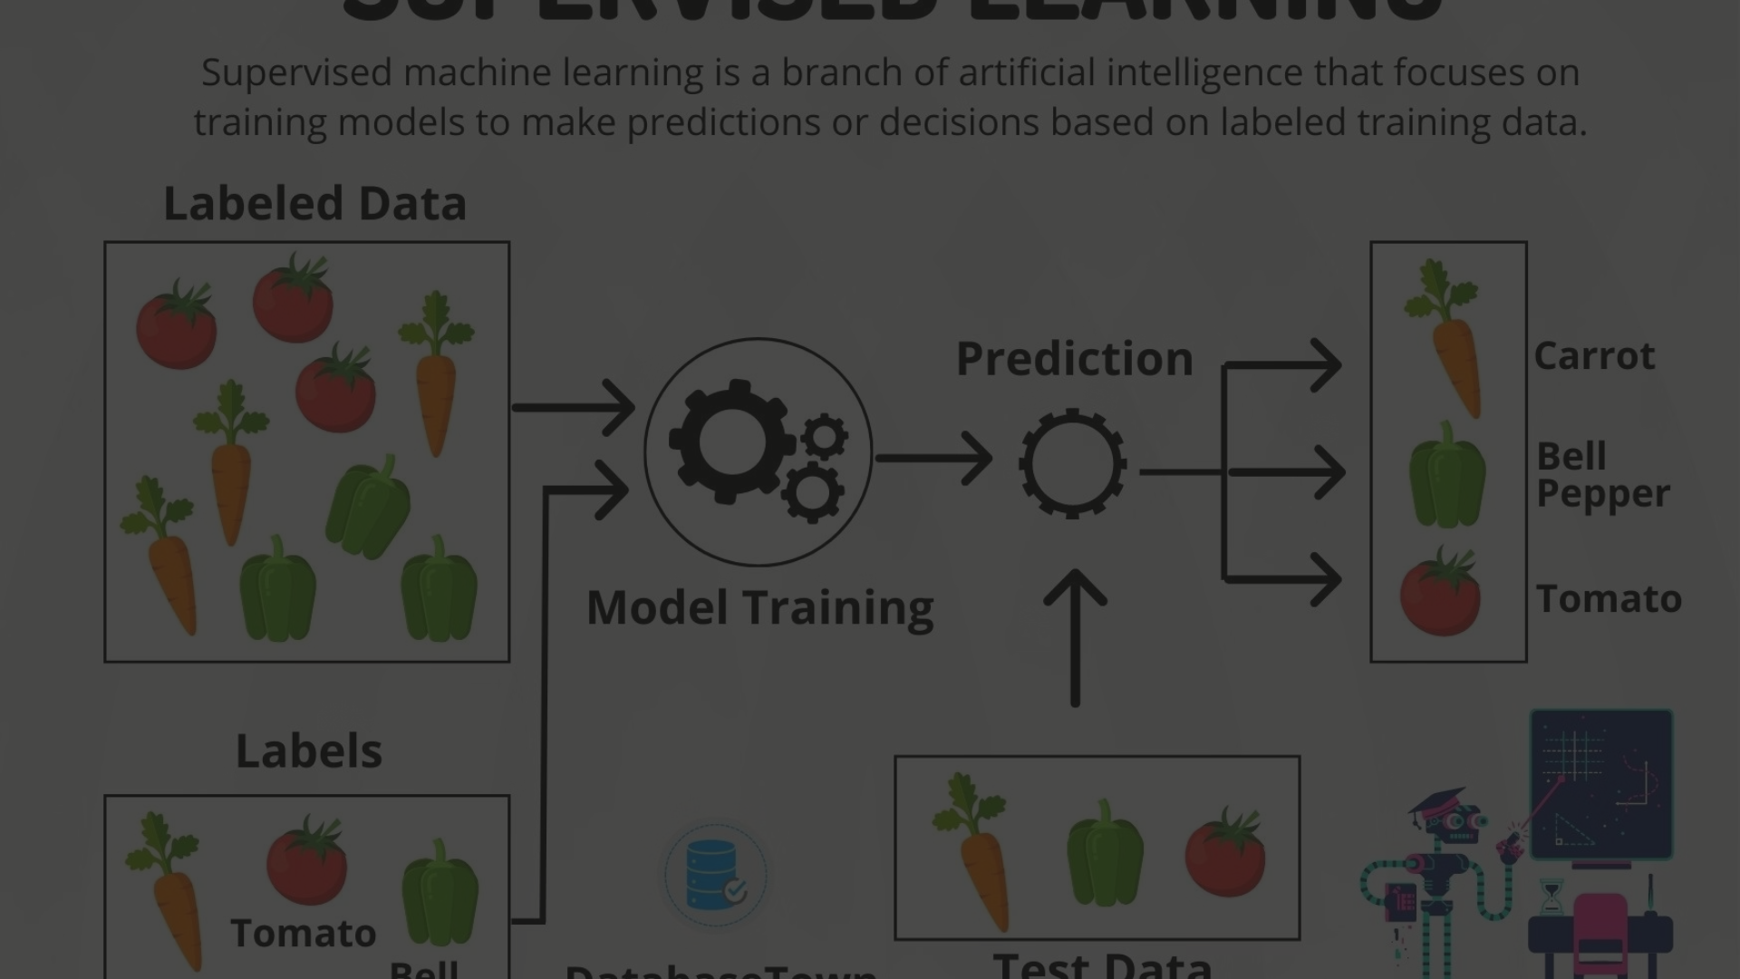
Supervised Learning
Labeled Data
Learn from Examples
Predict Outputs
In supervised learning, the algorithm is provided with labeled training data, meaning the inputs have known outputs or target variables.
Supervised learning models are trained to predict the target variable for new inputs, making them useful for a variety of applications like classification and regression.
The algorithm analyzes the training data to learn a function that maps the inputs to the outputs, which can then be applied to new, unseen data.

Slide 6
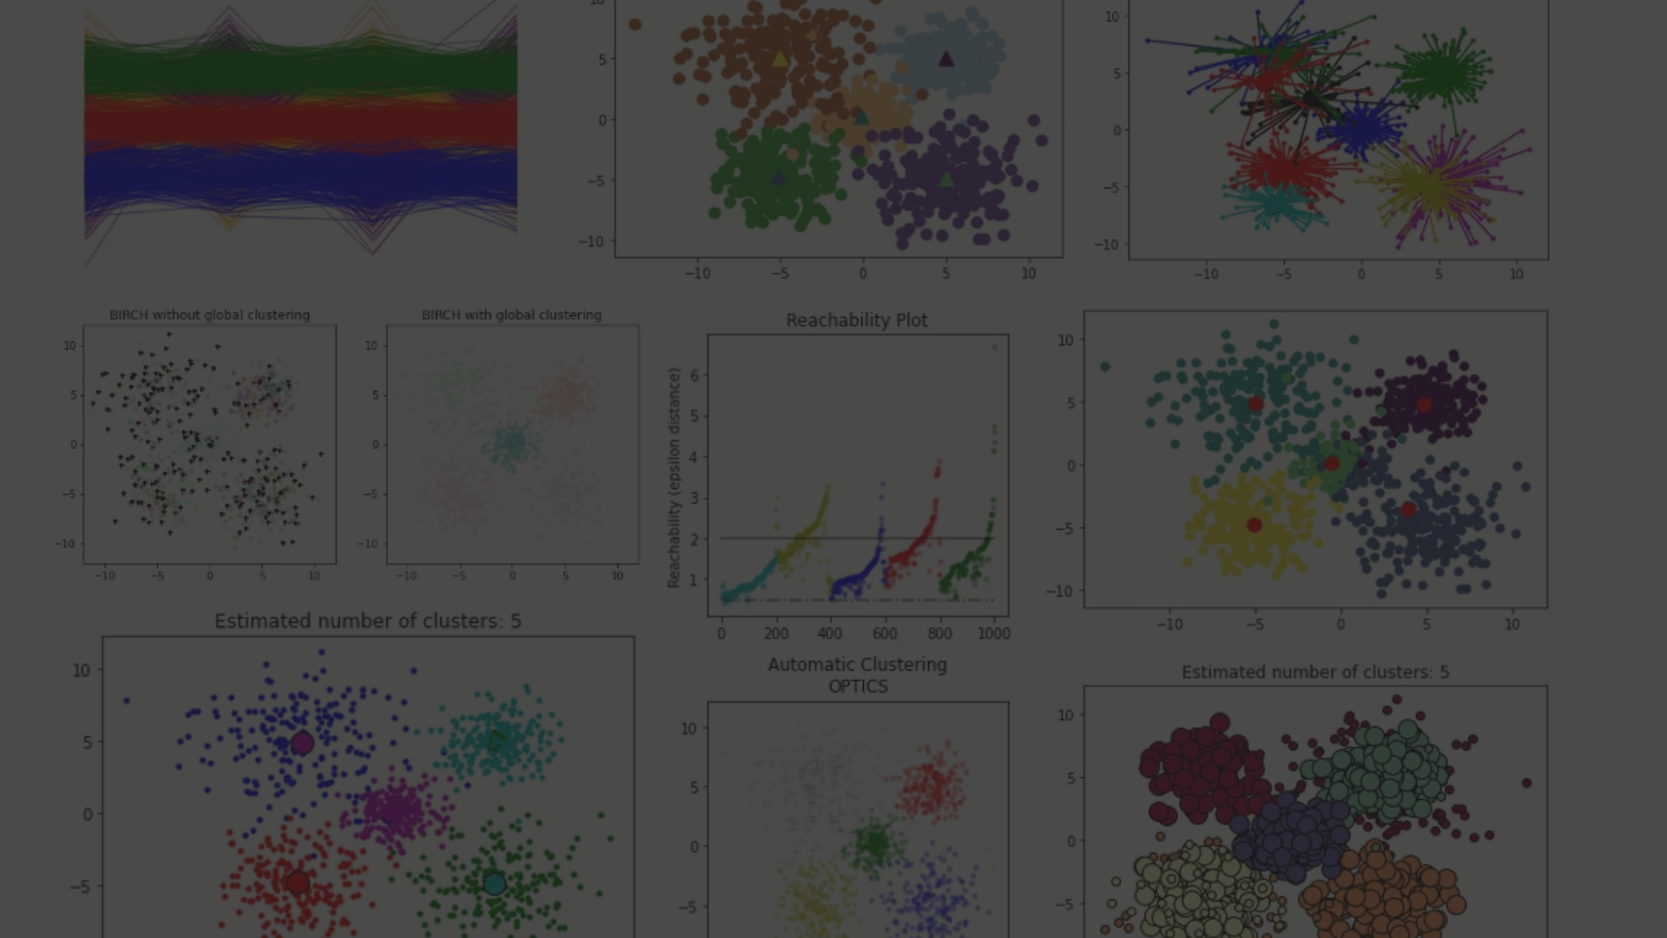
Unsupervised Learning
No Labels Needed
Clustering Algorithms
Dimensionality Reduction
In unsupervised learning, the algorithm explores data on its own without any labeled examples or predetermined outcomes. The goal is to uncover hidden patterns and relationships in the data.
Common unsupervised techniques include clustering algorithms like K-Means and DBSCAN, which group similar data points together based on inherent similarities.
Unsupervised learning can also be used for dimensionality reduction, simplifying complex data into fewer meaningful features using techniques like Principal Component Analysis (PCA).

Slide 7
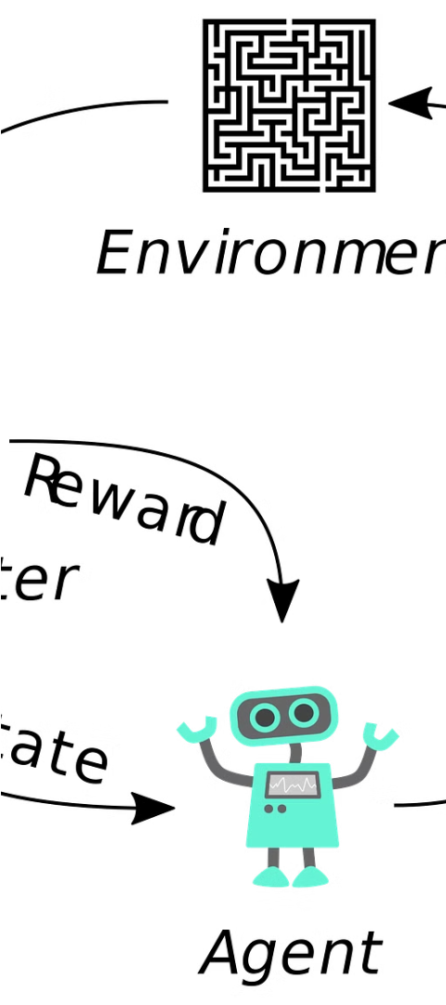
Reinforcement Learning
Dynamic Interaction
Trial-and-Error
Reinforcement learning involves an agent dynamically interacting with its environment, learning from the consequences of its actions to maximize rewards.
The agent experiments with different behaviors, receives feedback in the form of rewards or penalties, and adjusts its actions accordingly to improve performance.
Autonomous Learning
Unlike supervised learning, reinforcement learning allows the agent to learn on its own without relying on labeled training data or explicit instructions.

Slide 8
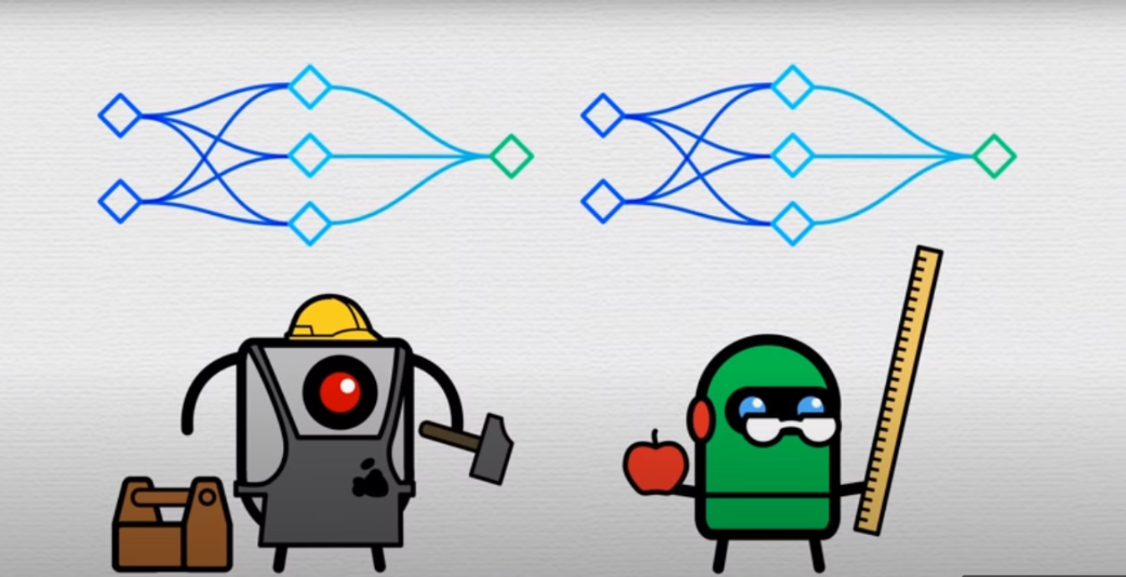
How Builder Robots and Teacher Robots Power Machine Learning

Slide 9
Classic AI Route Finding vs. Machine Learning
Classic Algorithms
Machine Learning
Traditional AI route finding algorithms use pre-programmed rules and mathematical models to determine the optimal path. They excel at predictable scenarios but struggle with complex, dynamic environments.
ML-powered navigation systems learn from data and can adapt to changing conditions. They leverage deep neural networks to analyze sensor inputs, identify patterns, and make real-time routing decisions.

Slide 10

The necessity of data
Jeffrey Hinton is a computer scientist who has made significant contributions to the field of artificial intelligence and deep learning. His work has helped to advance the use of neural networks in machine learning, and he is considered one of the pioneers of this field. Hinton has received numerous awards and honors for his research, including the Turing Award, which is often referred to as the "Nobel Prize of computing."

Slide 11
What is a Machine Learning Model?
A machine learning model is a mathematical representation that learns from data to make predictions or decisions without being explicitly programmed. It is the core component of a machine learning system, trained on historical data to recognize patterns and make informed forecasts or classifications. These models can adapt and improve over time as they are exposed to more data, making them powerful tools for a wide range of applications.

Slide 12

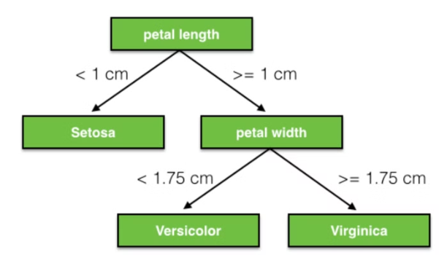
DECISION TREE
A decision tree is a supervised machine learning algorithm that is used for both classification and regression tasks. It represents a flowchart-like structure, where each internal node represents a feature or attribute, each branch represents a decision rule, and each leaf node represents the outcome or the class label. Decision trees are easy to understand and interpret, making them popular in various domains such as finance, healthcare, and marketing.

Slide 13
Applications of Machine Learning
Personalized Recommendation
Image and Speech Recognition
Fraud Detection
Disease Diagnosis
Machine learning models can quickly identify fraudulent transactions and activities, protecting businesses and consumers from financial losses.
ML-powered medical imaging analysis and predictive models are assisting doctors in earlier and more accurate disease diagnosis.
Machine learning powers the personalized product, content, and service recommendations we see on platforms like Amazon, Netflix, and Spotify, improving our user experience.
ML algorithms excel at analyzing visual and audio data, enabling technologies like facial recognition, self-driving cars, and voice assistants.

Slide 14
Pillars of ethics in machine learning
Fairness - Ensuring AI systems are unbiased and treat all individuals equitably, regardless of race, gender, or other protected characteristics.
Explainability - Making AI decision-making processes transparent and understandable, so users can trust the system's outputs.
Robustness - Designing AI models that are resilient to adversarial attacks, noisy data, and other real-world challenges.
Trust - Fostering a sense of confidence in AI systems through reliable performance, security, and respect for user privacy.
Deployment - Thoughtfully integrating AI into organizations and society, with appropriate safeguards and oversight.

